Slide 1
Spring MVC Validation
Avoid the Danger that has not yet come

Slide 2
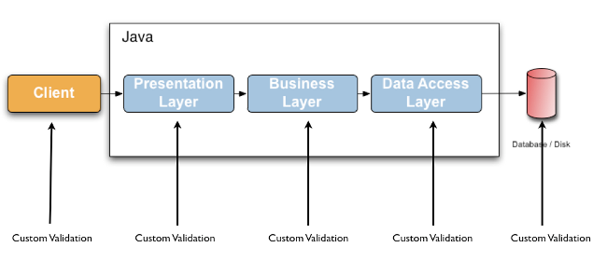
Validation
Validating data is a common task that occurs throughout all application layers, from the presentation to the persistence layer.
Validation:
should not be tied to the web tier
should be easy to localize
should be possible to plug in any validator available
Notes:
Often the same validation logic is implemented in each layer which is time consuming and error-prone. To avoid duplication of these validations, developers often bundle validation logic directly into the domain model, cluttering domain classes with validation code which is really metadata about the class itself.
https://docs.jboss.org/hibernate/stable/validator/reference/en-US/html_single/#preface

Slide 3
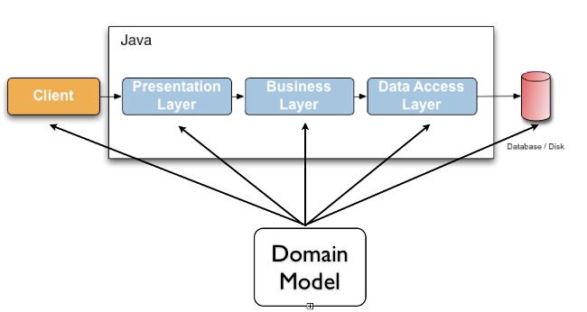
Spring Validation
Spring Validation uses a Validator interface that is basic and usable in every layer of an application. Additionally an application can use the Spring Validator directly without the use of annotations.
An application can choose to enable Bean Validation and the corresponding annotations for all validation needs.
Notes:
Java Specification Requests (JSRs) are the actual descriptions of proposed and final specifications for the Java platform.
https://stackoverflow.com/questions/48986091/hibernate-notempty-is-deprecated
https://stackoverflow.com/questions/49606316/java-bean-validation-2-0-vs-hibernate-validator

Slide 4
Bean Validation Intro
To do simple validation, use javax.validation.constraints annotations (also known as JSR-303/JSR-380 annotations).
JSR-303/JSR-380 is also know as the Bean Validation API
Bean Validation | Hibernate Validation | Java
1.1 | 5.4 series | 6+
2.0 | 6.0 series | 8+
Notes:
Hibernate Validator has a built-in Hibernate event listener - org.hibernate.cfg.beanvalidation.BeanValidationEventListener - which is part of Hibernate Annotations (as of Hibernate 3.5.x). Whenever a PreInsertEvent, PreUpdateEvent or PreDeleteEvent occurs, the listener will verify all constraints of the entity instance and throw an exception if any constraint is violated. .. f Hibernate Validator is present in the classpath, Hibernate Annotations (or Hibernate EntityManager) will use it transparently. To avoid validation even though Hibernate Validator is in the classpath set javax.persistence.validation.mode to none.
JDK 11 does not include JAXB anymore. Instead of relying on an external dependency and because our XML descriptors are quite simple, we decided to update our XML parsing layer to use StAX directly.
Thus, you can now use Hibernate Validator with JDK 11 without adding a dependency to a JAXB implementation.
http://in.relation.to/2018/07/18/hibernate-validator-6011-final-out/
https://stackoverflow.com/questions/22824843/what-does-reference-implementation-mean
https://stackoverflow.com/questions/49606316/java-bean-validation-2-0-vs-hibernate-validator
Bean Validation 2.0 focused on the following topics:
support for validating container elements by annotating type arguments of parameterized types e.g. List<@Positive Integer> positiveNumbers. This also includes:
more flexible cascaded validation of container types
support for java.util.Optional
support for the property types declared by JavaFX
support for custom container types
support for the new date/time data types (JSR 310) for @Past and @Future
new built-in constraints: @Email, @NotEmpty, @NotBlank, @Positive, @PositiveOrZero, @Negative, @NegativeOrZero, @PastOrPresent and @FutureOrPresent
leverage the JDK 8 new features (built-in constraints are marked repeatable, parameter names are retrieved via reflection)
You can consult an HTML diff between the 1.1 specification and the 2.0 specification here.
For more information, check out the full list of changes.
History

Slide 5
What’s new in Bean Validation 2.0?
support for validating container elements by annotating type arguments of parameterized types e.g. List<@Positive Integer> positiveNumbers. This also includes:
more flexible cascaded validation of container types
support for java.util.Optional
support for the property types declared by JavaFX
support for custom container types
support for the new date/time data types (JSR 310) for @Past and @Future
new built-in constraints: @Email, @NotEmpty, @NotBlank, @Positive, @PositiveOrZero, @Negative, @NegativeOrZero, @PastOrPresent and @FutureOrPresent
leverage the JDK 8 new features (built-in constraints are marked repeatable, parameter names are retrieved via reflection)

Slide 6
Use Case: Ensure Non-Empty Collection Elements
private List<String> names;
@NotEmpty private List<String> names;
private List<@NotEmpty @Pattern(regexp="[a-zA-Z]*") String> names;
@NotEmpty private List<@NotEmpty String> names;

Slide 7
Cascaded Validation
@Valid private List<Address> addresses;
private List<@Valid Address> addresses;
private Map<Integer, @Valid Address> addressMap;
private Map<@Valid AddressType, List<@Valid Address>> addressesByType;

Slide 8
Further Supported Containers
Optional, OptionalInt, OptionalLong, OptionalDouble
Optional<@Email String> getEmail() { ... };
JavaFX's property types

Slide 9
Validation Property Annotations [JSR-380]
Constraint | Description | Example
@AssertFalse | The value of the field or property must be false. | @AssertFalse boolean isUnsupported;
@AssertTrue | The value of the field or property must be true. | @AssertTrue boolean isActive;
@Email | The string has to be a well-formed email address | @Email String email;
@Digits | The value of the field or property must be a number within a specified range. | @Digits(integer=6, fraction=2) BigDecimal price;
@Future | The value of the field or property must be a date in the future. | @Future Date eventDate;
@Max | The value of the field or property must be an integer >= the value. | @Max(10) int quantity;
@Min | The value of the field or property must be an integer <= the value. | @Min(5) int quantity;
@NotNull | The value of the field or property must not be null. | @NotNull String username;
@Null | The value of the field or property must be null. | @Null String unusedString;
@Past | The value of the field or property must be a date in the past. | @Past Date birthday;
@Pattern | The value of the field or property must match the regular expression defined in the regexp element. | @Pattern(regexp="\\(\\d{3}\\)\\d{3}-\\d{4}") String phoneNumber;
@Size | The size of the field or property is evaluated and must match the specified boundaries. Can pertain to String, Collection, Map… | @Size(min=2, max=240) String briefMessage;
Hibernate JSR 380 Annotations
Notes:
Size of the First Name must be between 4 and 2,147,483,647 @Size with MIN but no MAX

Slide 10
Form Validation through Annotation
It's for Strings and collections.
Step 1：Annotate domain model properties
public class Employee {
private Long id;
@NotBlank // any characters besides "space"
@Size(min = 4, max = 50, message = "{Size.name.validation}")
private String firstName;
@NotBlank(message = "Enter the last name")
private String lastName;
@NotNull
@Past
@DateTimeFormat(pattern = "MM-dd-yyyy")
private LocalDate birthDate;
@NotNull
private Integer salaryLevel;
@Valid
private Address address;
public void setFirstName(String firstName) {
this.firstName = firstName.trim();
}
}
public class Address {
@NotEmpty(message = "{String.empty}")
private String street;
private String city;
@Size(min = 2, max = 2, message = "{Size.state}")
private String state;
}
use for Objects
Note: Curly {} brackets ensure that the text will be used as a property file lookup
Notes:
At first Spring will use setter-method to set value of property. And for validate value Spring will get it with getter-method.
That means, you can trim value in setter-method for prepare it to validation. See setFirstName()
2. lastName message will be replaced by external message
https://blog.csdn.net/liyuan932_a/article/details/80089431
https://stackoverflow.com/questions/25650152/enabling-hibernate-validation-fail-fast-in-java-config

Slide 11
Form Validation through Annotation (cont.)
Step 2: Externalize error messages in properties file
typeMismatch.java.lang.Integer={0} must be an integer
typeMismatch.java.util.Date={0} is an invalid date. Use format MM-DD-YYYY.
NotNull={0} is a required field
NotEmpty={0} field must have a value
Size.name.validation =Size of the {0} must be between {2} and {1}
address.zipCode=Zip Code
Spring organizes “placeholders” in alphabetical order. @Size(min=1,max=5), field name as {0} , the max value as {1} , and the min value as {2}.
Notes:
https://stackoverflow.com/questions/5786582/how-to-use-annotation-validation-in-spring-with-error-message-gotten-from-proper
Use debug mode to check Spring’s own message key

Slide 12
Form Validation through Annotation (cont.)
Step 3：Annotate model to be validated in the Controller method signature with @Valid:
@RequestMapping(value = "/employee_save")
public String saveEmployee(@Valid @ModelAttribute("employee") Employee employee, BindingResult bindingResult,
Model model) {
if (bindingResult.hasErrors()) {
return "EmployeeForm";
}
// save product here
model.addAttribute("employee", employee);
return "EmployeeDetails";
}
BindingResult IMMEDIATELY after model attribute
Notes:
Not good example, should use PRG

Slide 13
From Validation through Annotation (cont.)
Step 4：Display error in View
<form:form commandName="employee" method="post">
<p>
<form:errors path="*" cssStyle="color : red;" />
</p>
<p>
<label for="id">ID: </label>
<form:input path="id" id="id" />
<div style="text-align: center;">
<form:errors path="id" cssStyle="color : red;" />
</div>
</p>
</form:form>
Show ALL errors on Page
Show field level error

Slide 14
From Validation through Annotation (cont.)
Step 5：External error message and Validation configuration (Java Config version) – WebApplicationContextConfig.java
@Bean
public MessageSource messageSource() {
ResourceBundleMessageSource resource = new ResourceBundleMessageSource();
// resource.setBasenames("messages");
resource.setBasenames("messages", "errorMessages");
return resource;
}
@Bean(name="validator")
public LocalValidatorFactoryBean validator() {
LocalValidatorFactoryBean bean = new LocalValidatorFactoryBean();
bean.setValidationMessageSource(messageSource());
return bean;
}
@Override
public Validator getValidator() {
return validator();
}

Slide 15
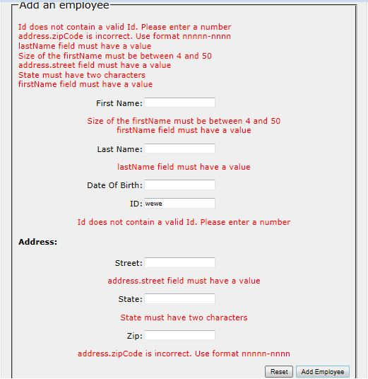
Notes:
Message order issue:
https://stackoverflow.com/questions/11804879/error-messages-are-not-in-the-correct-order
https://javapointers.com/tutorial/spring-mvc-validation-order-example/

Slide 16
Typemismatch
Non-String – if value cannot be converted to the data-type then an Exception is thrown.
Define the error message for type mismatch [e.g.]:
typeMismatch.java.lang.Integer="{0}" must be an integer.
typeMismatch.java.lang.Double="{0}" must be a double. typeMismatch.java.lang.Long="{0}" must be a long. typeMismatch.java.util.Date="{0}" is not a date.
Field Specific:
typeMismatch.id= Id is not valid. Please enter a number
Notes:
https://stackoverflow.com/questions/43574426/how-to-resolve-java-lang-noclassdeffounderror-javax-xml-bind-jaxbexception-in-j

Slide 17
Main Point
Validation checks the correctness of data against business rules. This prevents problems in the business model from arising.
In Cosmic Consciousness, life is lived stress-free; problem-free.

Slide 18
Manual Validation [W/O Annotations]
Object Validator implements Validator interface.
public class MemberValidator implements Validator {
@Override
public boolean supports(Class<?> c) {
return Member.class.isAssignableFrom(c);
}
@Override
public void validate(Object command, Errors errors) {
String[] errorArgs = { "First Name" };
ValidationUtils.rejectIfEmptyOrWhitespace(errors, "firstName", "NotEmpty", errorArgs);
errorArgs = new String[] { "Last Name" };
ValidationUtils.rejectIfEmptyOrWhitespace(errors, "LastName", "NotEmpty", errorArgs);
Member member = (Member) command;
if (member.getMemberNumber() == null || member.getMemberNumber() <= 0)
errors.rejectValue("memberNumber", "Member.Number.lessthan");
if (member.getAge() < 18)
errors.rejectValue("age", "Member.age");
}
}
Notes:
This example isn’t the original one. It’s

Slide 19
Manual Validation (cont.)
InitBinder setting of validator can be used with @Valid
@InitBinder
protected void initBinder(WebDataBinder binder) {
binder.setValidator(new MemberValidator());
}
100% Manual Does NOT use @Valid; Looks like this:
@RequestMapping(value = "/add", method = RequestMethod.POST)
public String processAddNewMemberForm(@ModelAttribute("newMember") Member memberToBeAdded, BindingResult result) {
MemberValidator memberValidator = new MemberValidator();
memberValidator.validate(memberToBeAdded, result);
if (result.hasErrors()) {
return "addMember";
}
memberService.save(memberToBeAdded);
return "redirect:/members";
}
Notes:
To enable Spring validator, either use @Valid + @InitBinder or Manual do it.

Slide 20
Custom Validation Annotation
The annotation implementation must conform to Bean Validation API [JSR 303]
There are three steps that are required:
Define a default error message
Create a constraint annotation
Implement a validator

Slide 21
Step 1: Define Default Error Message
Put messages in errorMessages.properties file
com.packt.webstore.validator.ProductId.message = A product already exists with this product id.
Notes:
https://stackoverflow.com/questions/4512826/empty-validatedby-in-constraint

Slide 22
Step 2: Create the annotation
@Target Indicates the kinds of program element to which an annotation type is applicable.
@Retention Indicates how long annotations with the annotated type are to be retained.
@Constraint Specifies the validator to be used.
@Target({ ElementType.METHOD, ElementType.FIELD, ElementType.ANNOTATION_TYPE })
@Retention(RetentionPolicy.RUNTIME)
@Constraint(validatedBy = ProductIdValidator.class)
public @interface ProductId {
String message() default "{com.packt.webstore.validator.ProductId.message}";
Class<?>[] groups() default {};
public abstract Class<? extends Payload>[] payload() default {};
}
Identifies the default key for creating error messages
Groups are typically used to control the order in which constraints are evaluated, or to perform validation of the partial state of a JavaBean.
Payloads are typically used by validation clients to associate some metadata information with a given constraint declaration.
Notes:
http://dolszewski.com/spring/custom-validation-annotation-in-spring/
https://www.baeldung.com/spring-mvc-custom-validator
More interesting is the @Constraint annotation, which actually marks our annotation for use as a validation constraint. In the validatedBy attribute, we should declare the class that will contain actual validation logic.
the message() is the error message that is showed in the user interface and the additional code is most boilerplate code to conforms to the Spring standards.
The @Constraint annotation is what connects our annotation interface to our validation class. It must implement the ConstraintValidator interface that matches the custom annotation type and the target of the data being validated.
The other two member declarations are groups and payload and they are required by the validation run-time implementation. Failure to include either of these will also result in a run-time exception.
http://beanvalidation.org/1.1/spec/#constraintsdefinitionimplementation-constraintdefinition-groups

Slide 23
Step 3: Implement Validator
Annotation & Type to be validated
public class ProductIdValidator implements ConstraintValidator<ProductId, String> {
@Autowired
private ProductService productService;
@Override
public void initialize(ProductId arg0) {}
@Override
public boolean isValid(String value, ConstraintValidatorContext context) {
Product product = null;
try {
product = productService.getProductById(value);
} catch (Exception e) {
System.out.println("Couldn't find product...");
}
return product == null ? true : false;
}
}
Usage:
@Pattern(regexp = "P[1-9]+", message = "{Pattern.Product.productId.validation}")
@ProductId
private String productId;
add additional error messages or completely disable the default error message

Slide 24
Cross Field Validation
NEED: validate the combination of two or more fields
Similar to field level Validator BUT different
Class Level…Validation against entire Class object
public class StockMaximumValidator implements ConstraintValidator<StockMaximum, Product>{
BigDecimal maxValue = null;
public void initialize(StockMaximum constraintAnnotation) {
int maximum = constraintAnnotation.maximum();
maxValue = new BigDecimal(maximum);
}
@Override
public boolean isValid(Product product, final ConstraintValidatorContext context) {
BigDecimal unitPrice = product.getUnitsInStock();
Long unitsInStock = product.getUnitPrice();
BigDecimal currentValue = new BigDecimal(0);
if (unitsInStock > 0) {
currentValue = unitPrice.multiply(new BigDecimal(unitsInStock));
}
if (currentValue.compareTo(maxValue) >= 0) return false;
return true;
}
} See demo: webstore_validation

Slide 25
Main Point
Custom validation allows for handling more complex, extraordinary verification issues.
A quality of Cosmic Consciousness is the ability to know what is true and right in every situation.

Slide 26
Spring MVC Architecture & Annotations
Spring Annotations
Spring Managed Components:
@Controller Indicates a Controller component in the presentation layer.
@Service Indicates a Service component in the business layer
@Repository Indicates DAO component in the persistence layer.
@RequestMapping
@RequestParam
@ModelAttribute
@PathVariable
Handler Mapping
ViewResolvers
Views
Notes:
What does handler mapping do?

Slide 27
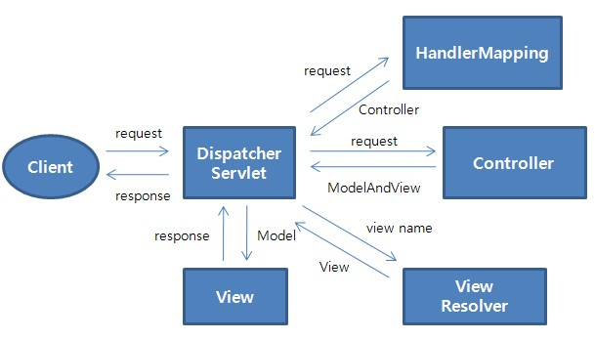
Spring MVC Flow

Slide 28
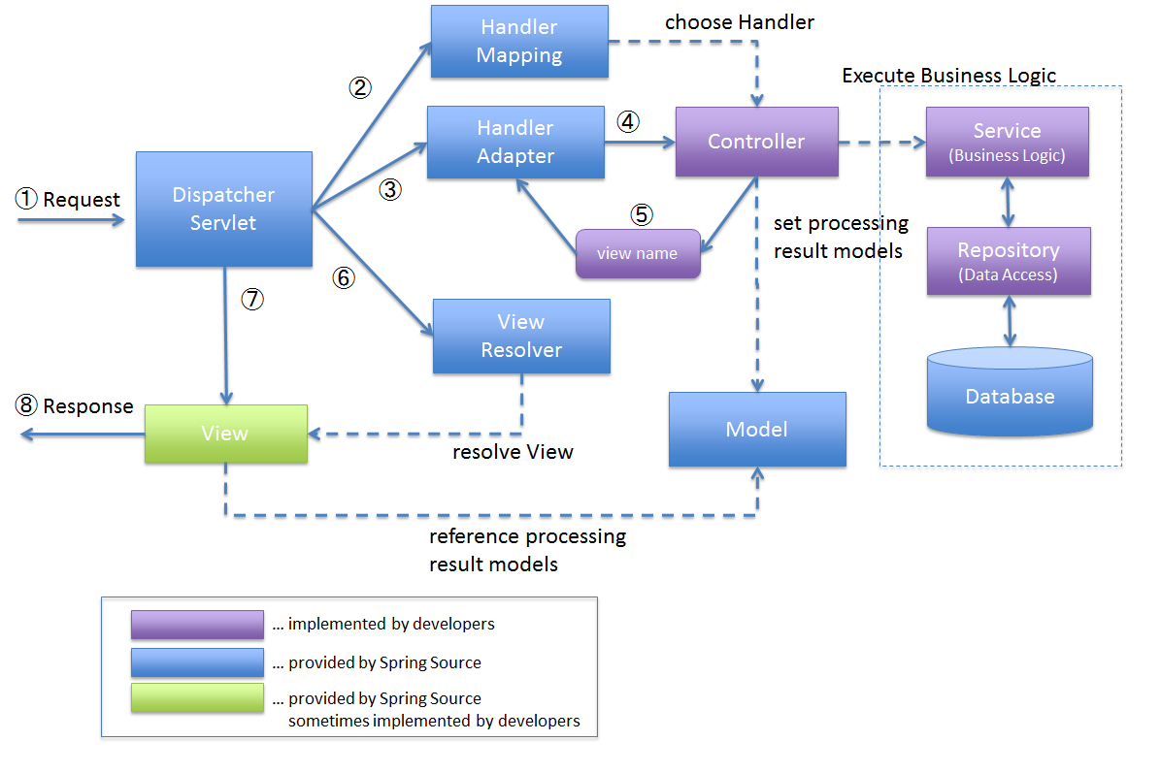
Spring MVC Flow More Details
Mapping chooses Controller
RequestMappingHandlerMapping
BeanNameUrlHandlerMapping
SimpleUrlHandlerMapping
…
Adapter interacts with Controller methods
RequestMappingHandlerAdapter
SimpleControllerHandlerAdapter
Notes:
SimpleControllerHandlerAdapter [for interface based controllers] -- BeanNameUrlHandlerMapping ?? SimpleUrlHandlerMapping ?? ControllerClassNameHandlerMapping
DefaultAnnotationHandlerMapping DEPRECATED
Spring controller inteface
http://docs.spring.io/spring/docs/current/javadoc-api/org/springframework/web/servlet/mvc/Controller.html

Slide 29
Handler Mapping
Using a handler mapping you can map incoming web requests to appropriate handlers.
When a request comes in, the DispatcherServlet will hand it over to the handler mapping to let it inspect the request and come up with an appropriate HandlerExecutionChain.
Notes:
https://docs.spring.io/spring/docs/3.0.0.M3/reference/html/ch16s04.html
http://www.javainterviewpoint.com/spring-mvc-handler-mapping/

Slide 30
HandlerMapping
The Handler Mapping is used to map a request from the Client to its Controller object by searching through the various Controllers.
BeanNameUrlHandlerMapping *******default******
The URL of the Client is directly mapped to the Controller
<bean name="/ProductForm.do" class="edu.mum.controller.InputProductController"/>
RequestMappingHandlerMapping *******default******
Maps handlers through the RequestMapping annotation at the type or method level.
ControllerClassNameHandlerMapping
<bean class="org.springframework.web.servlet.mvc.support.ControllerClassNameHandlerMapping" />
<bean class="edu.mum.controller.WelcomeController" />
WelcomeController maps to the '/welcome*' URL based on naming
SimpleUrlHandlerMapping
Keys defined on bean definition:
<bean class="org.springframework.web.servlet.handler.SimpleUrlHandlerMapping">
<property name="mappings"> <props> <prop key="/welcome.htm">welcomeController</prop> <</props> </property>
</bean>
<bean id="welcomeController" class="com.mkyong.common.controller.WelcomeController" />

Slide 31
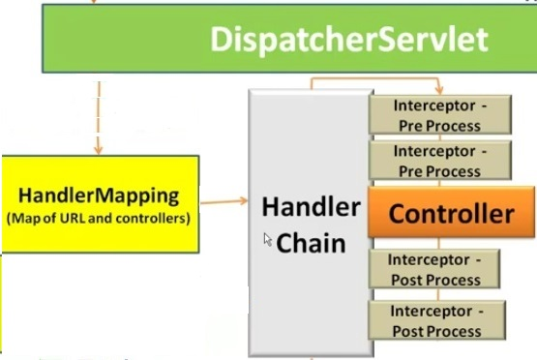
Handler Chaining
Notes:
https://examples.javacodegeeks.com/enterprise-java/spring/mvc/spring-mvc-interceptor-tutorial/

Slide 32
Interceptor Configuration
Java Config Version – Inside WebApplicationContextConfig class
@Override
public void addInterceptors(InterceptorRegistry registry) {
registry.addInterceptor(new ProcessingTimeLogInterceptor());
}

Slide 33
Interceptor Implementation
public class ProcessingTimeLogInterceptor implements HandlerInterceptor {
private static final Logger LOGGER = Logger.getLogger(ProcessingTimeLogInterceptor.class);
@Override
public boolean preHandle(HttpServletRequest request, HttpServletResponse response, Object handler)
throws Exception {
long startTime = System.currentTimeMillis();
request.setAttribute("startTime", startTime);
return true;
}
@Override
public void postHandle(HttpServletRequest request, HttpServletResponse response, Object handler,
ModelAndView modelAndView) throws Exception {
String queryString = request.getQueryString() == null ? "" : "?" + request.getQueryString();
String path = request.getRequestURL() + queryString;
long startTime = (Long) request.getAttribute("startTime");
long endTime = System.currentTimeMillis();
LOGGER.info(String.format("%s millisecond taken to process the request %s.", (endTime - startTime), path));
}
@Override
public void afterCompletion(HttpServletRequest request, HttpServletResponse response, Object handler, Exception ex)
throws Exception {
//Callback after rendering the view.
}}
Notes:
preHandle – add resources…that you need in handler
Posthandle – add to model for display
afterCompletion – remove FlashAttributes….remove @SessionAttributes

Slide 34
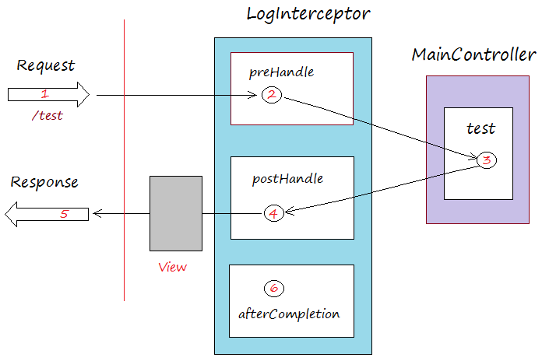
Interceptor Implementation

Slide 35
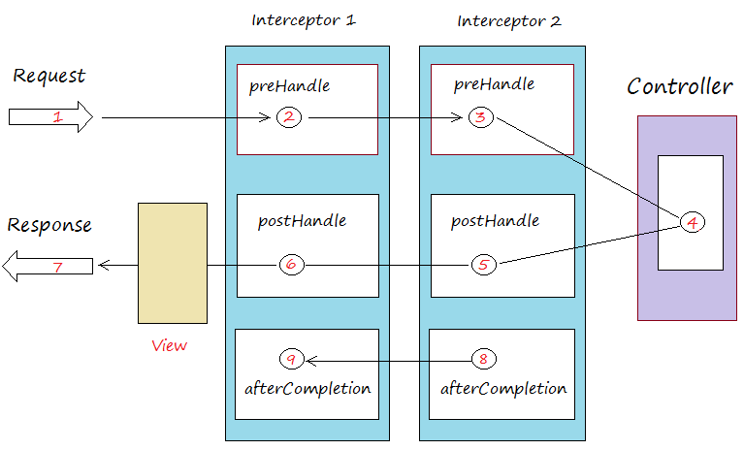
Interceptor Implementation

Slide 36
Main Point
Handler Mapping & Chaining aids in organizing functionality in layers. As a result the design is simpler & more consistent.
Life is structured in layers. This orderliness within us and around us allows us to enjoy more efficiency in our life.

